Slide 1


Airbnb Listing
Price Prediction
Dongni Yang, Lingjie Yang, Jing Tang, Wen Zhang

Slide 2

Business Problem
Data
Agenda
EDA
Feature Selection &
Feature Engineering
Model
Conclusion

Slide 3


Business Problem
5556
We aim to develop and validate a prediction model for Amsterdam's Airbnb listing price, and identify factors that are most relevant to the price.
Temporary housing listings on Amsterdams

Slide 4



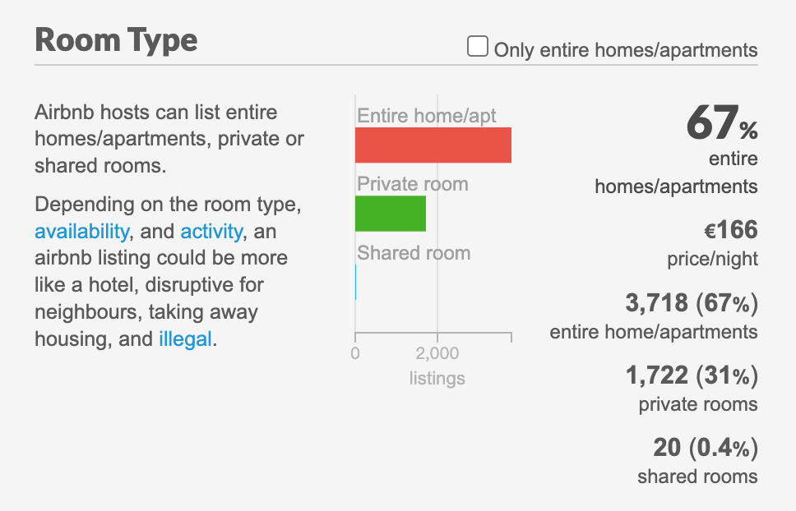
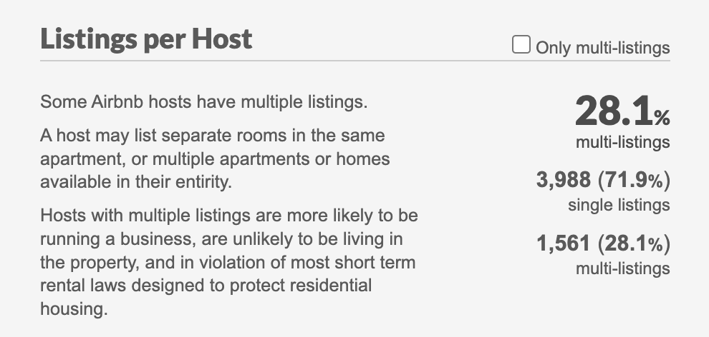
Data Source
Amsterdam Detailed Listings data:
http://insideairbnb.com/get-the-data.html
5556
74
4 Fields
Data
Column
Room Type
Activity
Availability
Listings per Host

Slide 5
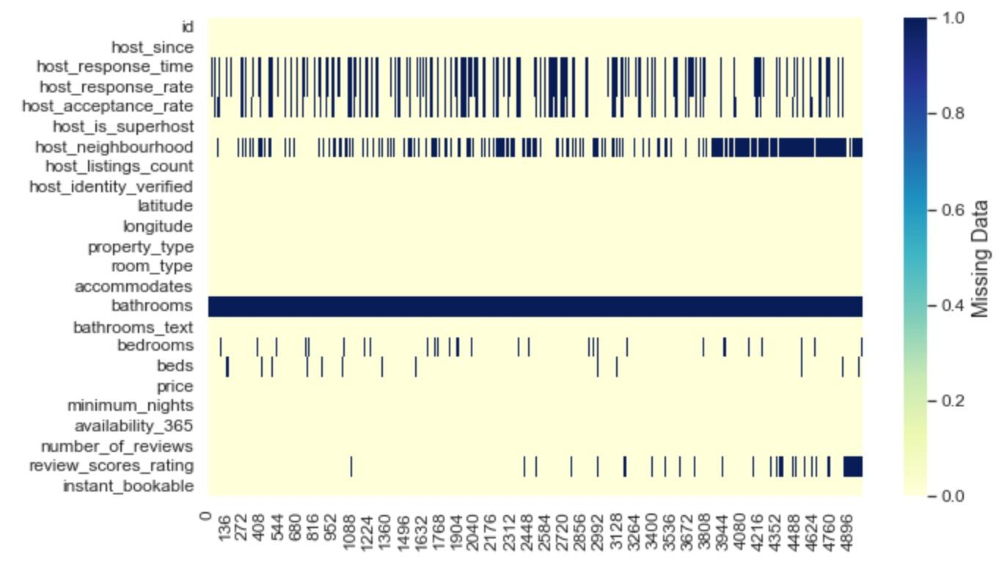
EDA
Drop columns containing more than 25% of missing
For numeric missing
(bedrooms, review_score_rating, beds), impute with mean value
Replace missing value for categorical attributes with the most frequent counts

Slide 6
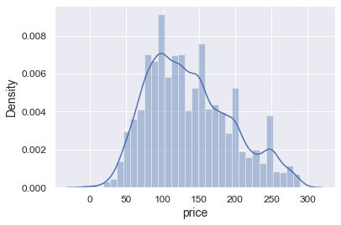
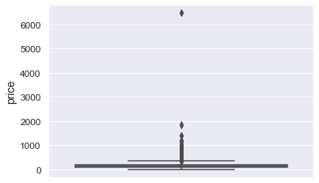
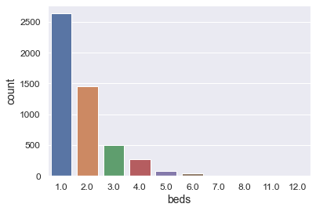
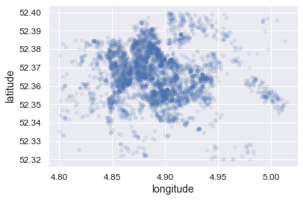
EDA
Price boxplot
Density Distribution
2D Map
Beds count barplot

Slide 7
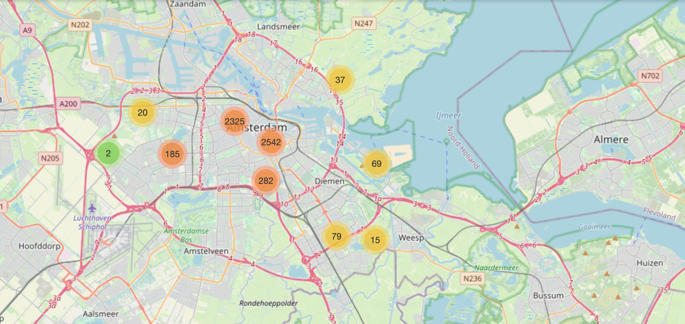
EDA-Interactive Map

Slide 8
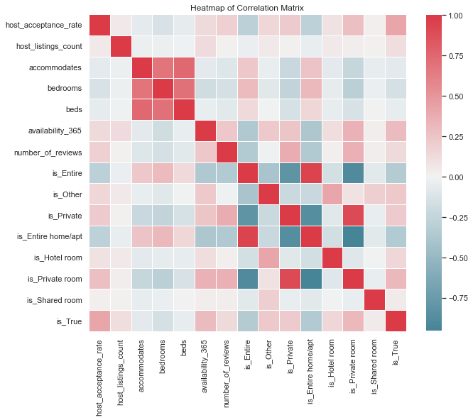
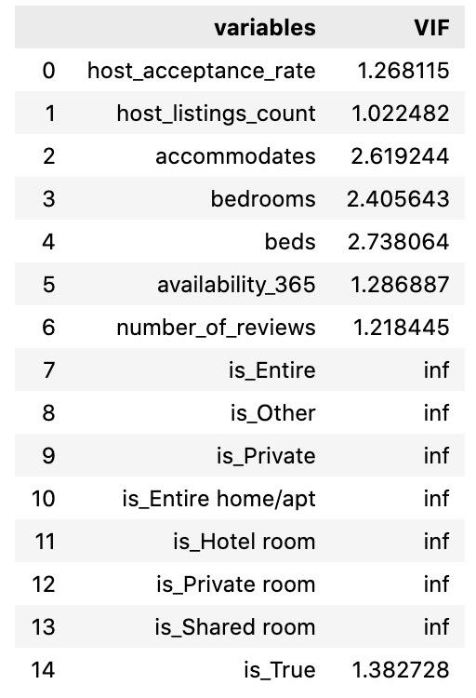
Feature Selection & Engineering
Create composite variables
(is_private_bath, property_type that distinguish private and shared listing)
Delete outliers according to location
Check for collinearity and drop highly correlated columns
Convert existing categorical variables into dummy variables
Using the K highest score and VIF to perform feature selection
Drop the columns with high correlation
VIF

Slide 9
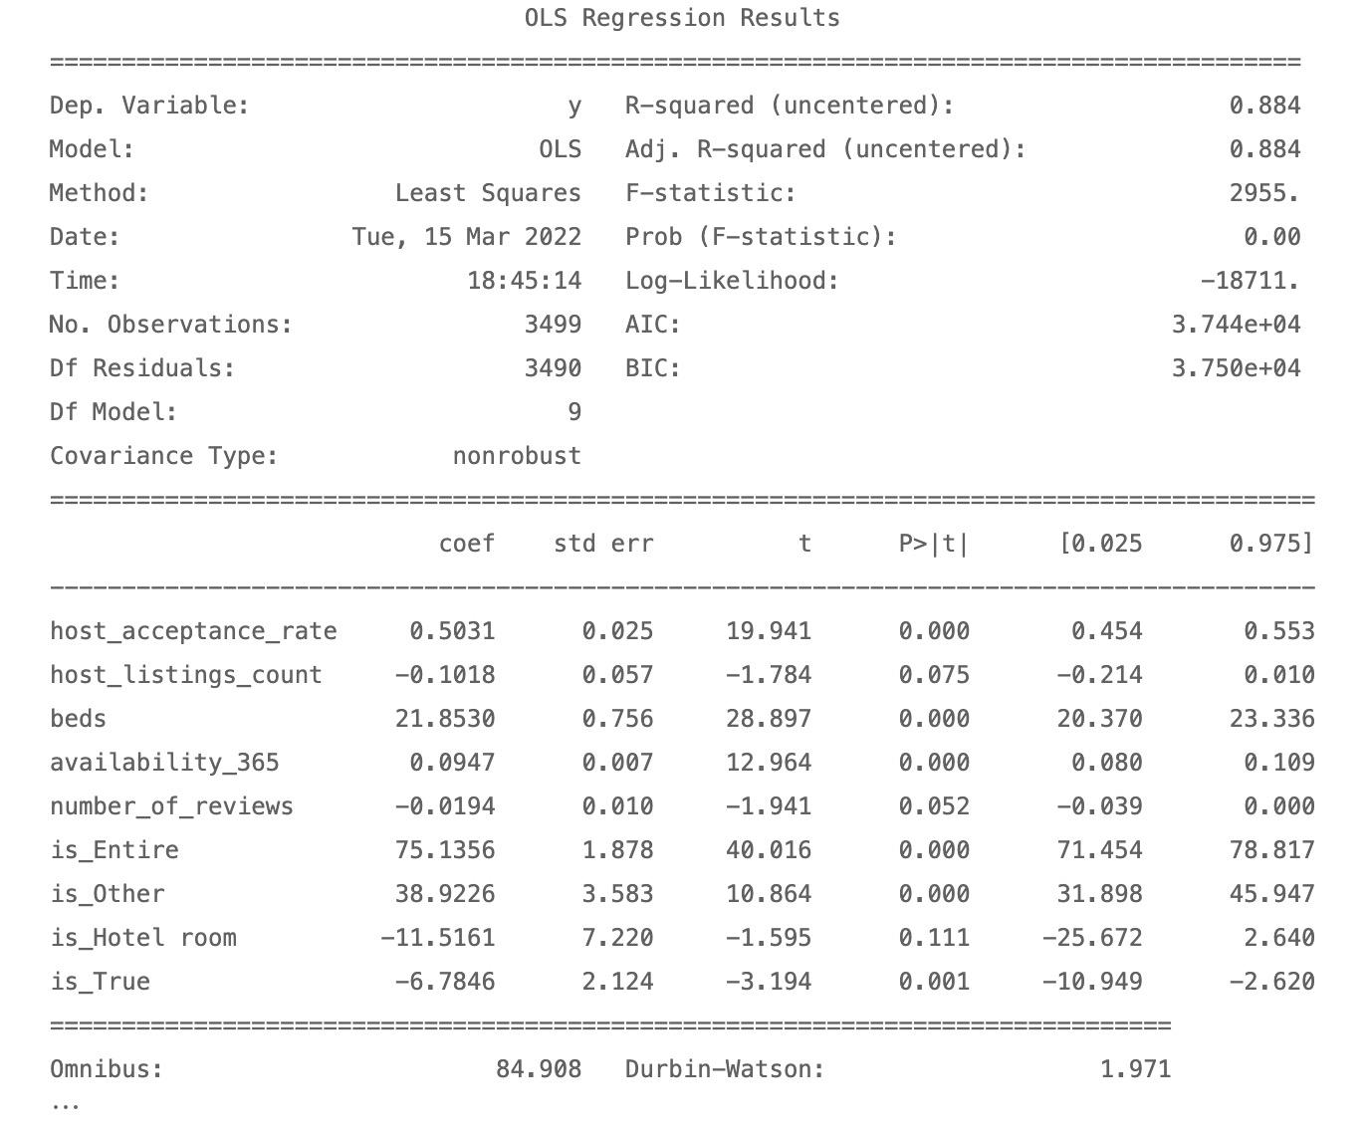
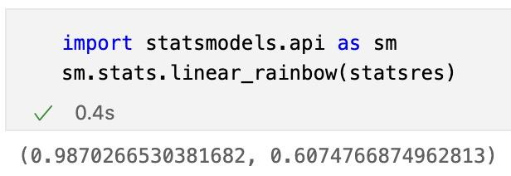
OLS Model
Fit OLS Model
Perform diagnostics and goodness of fit tests on the model
10.6M

Slide 10






Conclusion
Good Host
Good Review
Property Type
Host acceptance rate
Host listings count ×
High review scores rating
Number of reviews ×
Entire house ☆☆
Other Type ☆
Boating.etc.
Private Type
Beds
Room Situation
Availability
Entire home/apt
Hotel room ×
Private room
Shared room
Beds number ☆
Instant bookable ×

